Slide 1
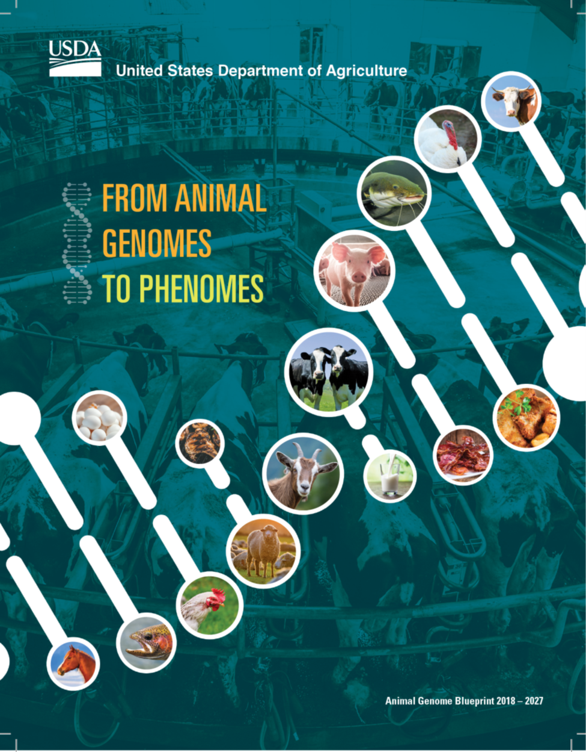
Frontiers in Genetics May 2019 Volume 10:327 doi: 10.3389/fgene.2019.00327

Slide 2
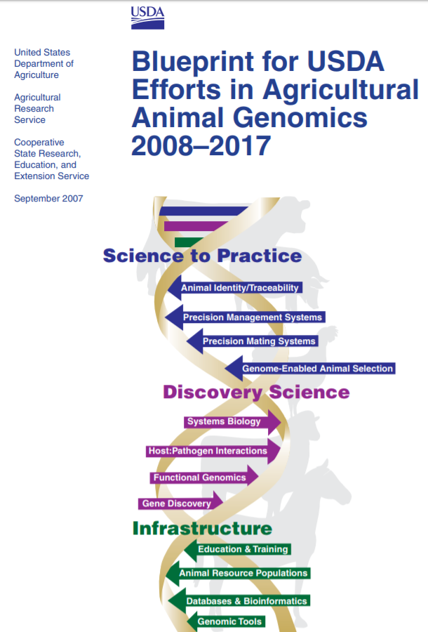
Original Blueprint task force
Established by USDA’s Under Secretary for Research, Education and Economics, Joseph Jen in 2007
USDA leadership
Ronnie Green (USDA-ARS) Chair
Muquarrab Qureshi (USDA-CSREES) Co-chair

Slide 3
2008-2017 Infrastructure Goals
Assembled and Annotated Genomic Sequences:
10X – cattle, chicken and swine
6X – catfish, equine, salmon, sheep, tilapia and turkey
2X – goat, oyster, shrimp and trout
Many of the goals from the 2008-2017 Blueprint have been realized. However, new goals have emerged from previous research efforts requiring an updated Blueprint.

Slide 4
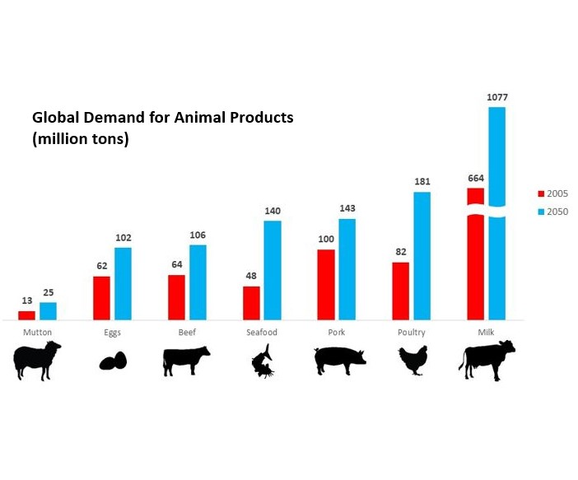
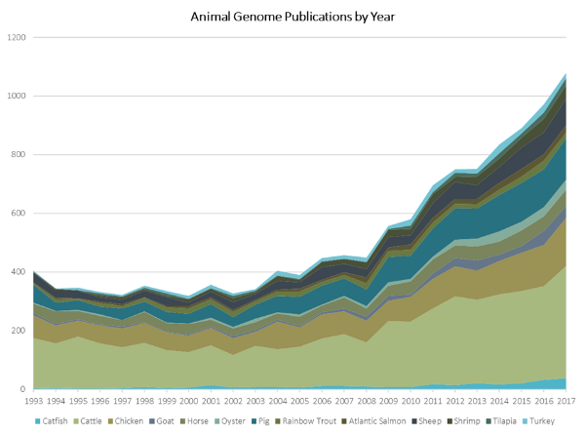
More prompt for Blueprint 2018-2027
The global demand for animal products is expected to dramatically increase by 2050¹.
Genomics publications per year have nearly tripled in the last two decades².
¹Modified from Future of Food 2013 (https://www.gatesnotes.com/About-Bill-Gates/Future-of-Food).
²From Appendix 5, A New USDA Blueprint for Animal Genome Research 2018 – 2027, Front. Genet. 10:327. doi: 10.3389/fgene.2019.00327.

Slide 5
New Blueprint taskforce
  Jim Reecy (Iowa State University)
  Support from USDA-NIFA and USDA-ARS-NAL
USDA leadership
  Jeff Vallet (USDA-ARS)
  Caird Rexroad (USDA-ARS)
  Lakshmi Matukumalli (USDA-NIFA)

Slide 6
Themes, Topics and Goals for Blueprint 2018-2027
Science to Practice
  Precision Selection and Management
Discovery Science
  Genome and Functional Biology
  Host-Pathogen Interactions
  Phenotyping
  Microbiome and Metagenomics
Infrastructure
  Genome Tools and Resources
  Education and Training
  Bioinformatic and Computational Biology
  Biotechnology
  Animal Populations and Germplasm Preservation
Goal 1: Providing Nutritious Food to a Growing Human Population
Goal 2: Increasing Animal Fitness and Improving Animal Welfare
Goal 3: Improving Sustainability of Animal Agriculture
Goal 4: Meeting Consumer Needs and Choices

Slide 7
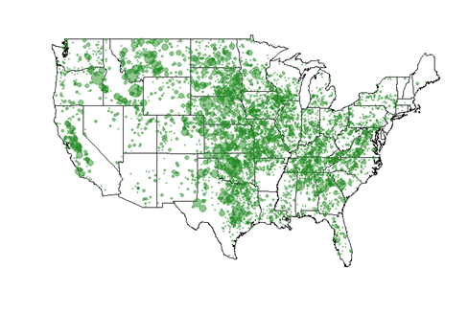
Science to Practice
a) Optimizing Animal Production through Precision Breeding and Management
Action
Environment-specific production values for breeding are needed for precision sorting.
New genomic technologies to enhance nonadditive inheritance effects like heterosis and epigenetic mechanisms.
Map of 521,645 genotyped Angus, opportunities exist to incorporate environment into genomic predictions³.
³Figure kindly provided by Dan Moser, American Angus Association and Front. Genet. 10:327. doi: 10.3389/fgene.2019.00327.

Slide 8
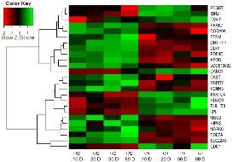
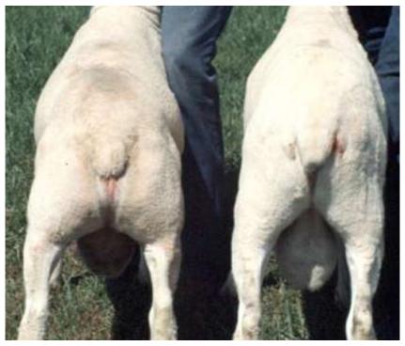
Discovery Science
a) Understanding Genome Biology to Accelerate Genetic Improvement of Economically Important Traits
Action
More efforts in gene functionality (FAANG).
Gene orthologue validation from model organisms.
Changes in gene expression results in the callipyge, Greek for “beautiful buttocks”, phenotype⁴.
⁴From Fleming-Waddell JN et al. PloS one. 2009 Oct 9;4(10):e7399.

Slide 9
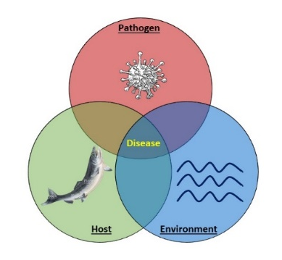
Discovery Science
b) Reducing the Impacts of Animal Diseases
Action
More comprehensive animal disease surveys and databases.
Identify measurable immune activity and physiological indicators in healthy individuals.
Continued development of livestock -specific biological reagents.
The host-pathogen-environment interactions must be examined to identify disease resistance/tolerance.

Slide 10
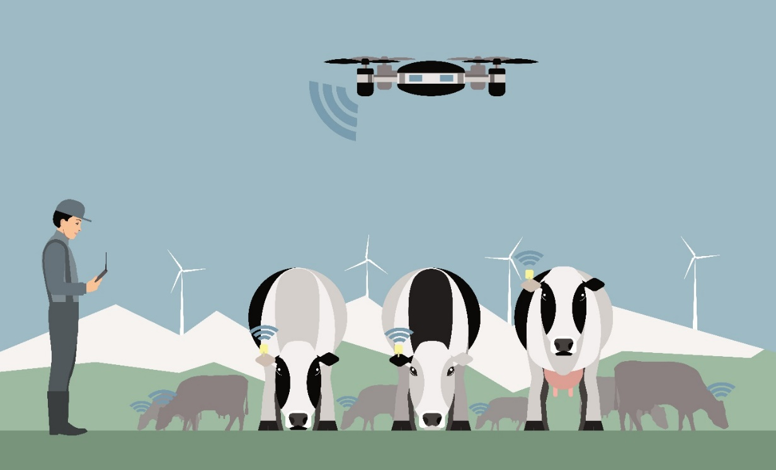
Discovery Science
c) Applying Precision Agriculture Technologies to Animal Phenotyping
Action
Shift from genotyping to phenotyping. Define useful phenotypes, sensor development, and data infrastructure.
Development of electronic sensors combined with improved on farm data infrastructure to automate data collection⁵.
⁵Shutterstock image753946003.

Slide 11
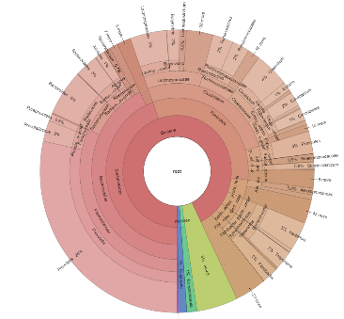
Discovery Science
d) Harnessing the Microbiome to Improve the Efficiency and Sustainability of Livestock Production
Action
Adequate microbial reference genomes
Determine role of microbiome during different animal states
  Disease
  Production facilities
  Environments
Every individual animal is a collection of organisms, made up of the host animal, and its microbiome, the symbiotic, commensal and often parasitic or pathogenic organisms that reside either in or on the animal that can affect animal productivity⁶.
⁶Photo of microbiome used with permission from Derek Bickhart.

Slide 12
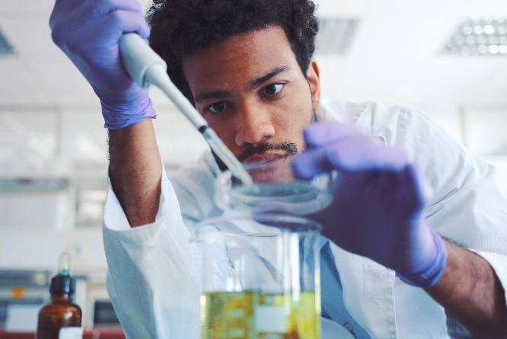
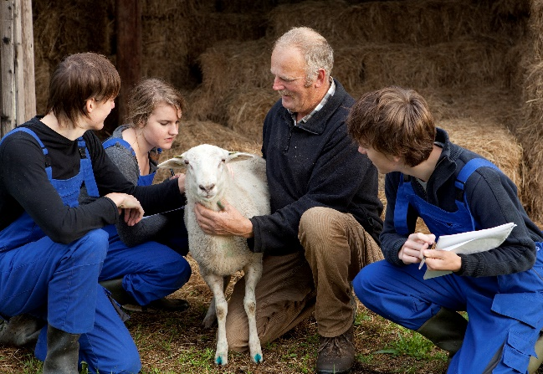
Infrastructure
a) Training the Next Generation of Animal Scientists
Action
Training for expert on-farm data collection. At all levels, curricula that integrate computational instruction with production experience are needed.
A multidisciplinary approach that includes computation, molecular biology, and animal production experience is required to train the next generation of animal scientists⁷.
⁷iStock photos 184602304 and 683253578

Slide 13
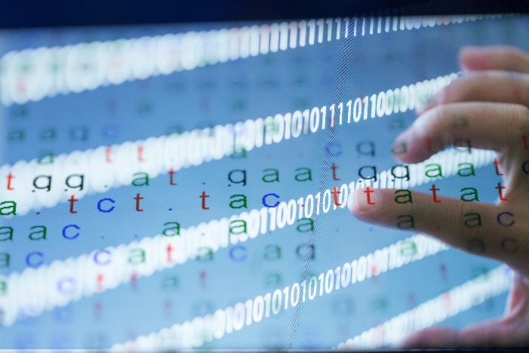
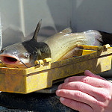
Infrastructure
b) Developing Advanced Genomic Tools, Technologies, and Resources for Agricultural Animals
Action
Pan-genomes are needed for each species. Improved technologies and analysis of various omics techniques.
To be fully useful, genomes must be annotated to include information on the portions of sequence that control protein amino acid sequences, gene transcription and higher order genomic architecture⁸.
⁸Catfish photo flickr 7463089188_38cd90f7ed_k; Genetic code photo iStock 695176924.

Slide 14

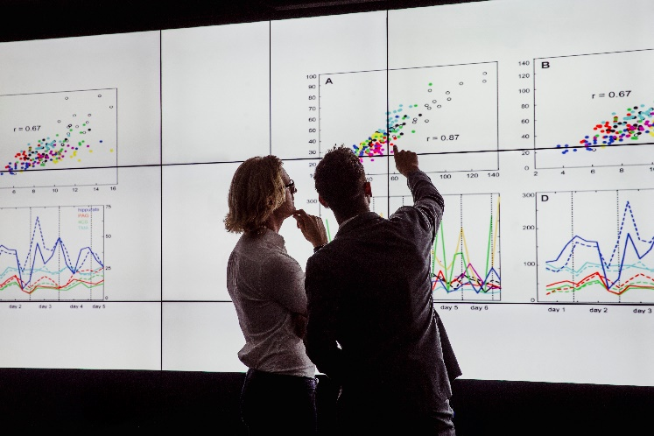
Infrastructure
c) Creating Big Data Tools and Infrastructure for Animal Production
Action
Better and faster software algorithms to effectively analyze these data, and data standards and defined interconnectivity among data will be needed. Along with support for permanent data storage.
Hardware, tools, and data standards are required to support big data⁹.
⁹Servers flickr phto 14650699941_da30665d1_k; iStock photo 872019580.

Slide 15
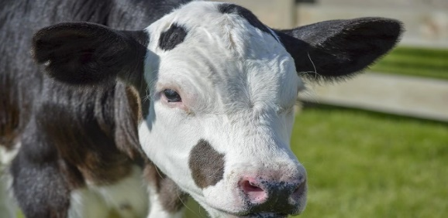
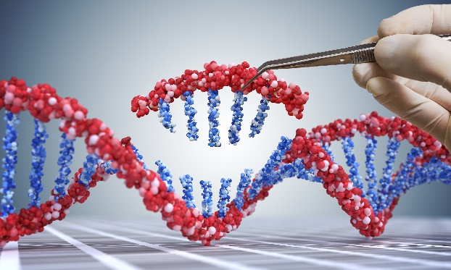
Infrastructure
d) Advancing Biotechnology to Improve the Sustainability and Efficiency of Animal Production
Action
Improvements in in vitro fertilization of elite females
Development of embryo genomic selection methods
Cloning technologies to expand the population size of embryos with elite desirable genotypes and in new species
Research to increase the number of possible modifications in a single individual
Gene editing by CRISPR/Cas9 can be used to improve animal welfare: one example is the development of hornless cows¹⁰.
¹⁰Gene edited bull calf, photo credit: Hannah Smith Walker, Cornell Alliance for Science. DNA editing photo iSTock 104030074.

Slide 16
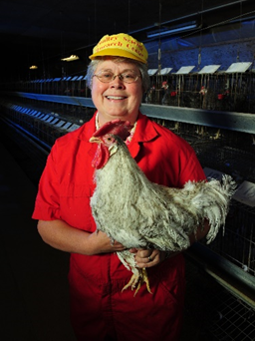
Infrastructure
e) Characterizing and Preserving Genetic Diversity for the Future of Animal Production
Action
Preserve current genetic resources to ensure their availability for addressing challenges in the future.
Determine effective preservation methods not yet available for all livestock species.
Sue Lamont holds an inbred chicken from a line used frequently for disease resistance/tolerance studies at Iowa State University.

Slide 17
Acknowledgement
These slides were originally created by Angelica Van Goor based on the Animal Genome Blueprint Executive Summary
Funding to support the workshop was awarded to Jim Reecy from the USDA-NIFA-AFRI grant 2017-67015-26907 project accession 1013525, with additional support from the ARS office of National Programs and by the National Agricultural Library.

